Slide 1

Project 1 – Guess The Number
Michel Brun
Abdelaziz Mtimet
Notes:
Michel

Slide 2
Game description
Given an integer N.
A number guessing game is a simple guessing game where a user is supposed to guess a number between 0 and 100 in a maximum of 10 attempts.
The game will end after 10 attempts and if the player failed to guess the number, and then he loses the game.
Notes:
Abdel

Slide 3
Process
Define the task on Jira
Understanding the rules of the game
Creating a repertory on GitHub
Getting a pseudo code
Coding using while and if method and including a function
Checking the code
Testing the code
Preparing the presentation
Notes:
Abdel

Slide 4
Challenges
Getting used to Jira
Sharing wisely the work
Understanding the game
Identifying all the potential wrong input such as « no digit » or number out of 1 to 100 range
Including a STOP entry
Using a function
Notes:
Michel

Slide 5
Highlights
Understanding the problem
Writing the code
Testing the code
Notes:
Abdel

Slide 6
Demo
Notes:
Michel

Slide 7
Q&A

Slide 8
Thank you

Slide 9
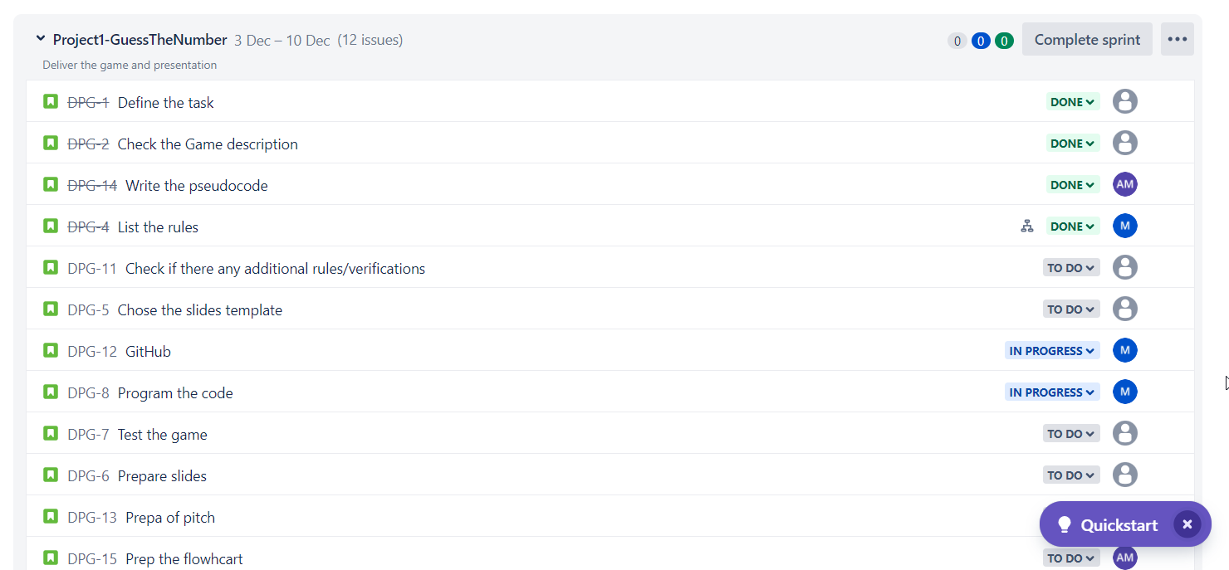
Project Management using Jira

Slide 10
Pseudo code
Generate a random number between 0 and 100 and assign that random number to a variable.
Ask the player to guess a number
Compare the players guess and the secret number. The program should tell the player if their guess is higher or lower than the secret number
Your program must tell the player if they have won
Your program must ask the player if they want to play again

Slide 11
Code 1/3
#import random at first
import random
import re
#define the guess number between 1 and 100
#function that returns a random integer between a and b number
def rand(a,b):
return random.randint(1, 100)
#define the guess number between 1 and 100
number = rand(1, 100)
print(" --- Welcome to Guess The Number ---\n - Your goal is to guess a number ! -\n Enter STOP to stop the Game")
#define number of guesses
number_of_guesses = 0

Slide 12
Code 2/3
while number_of_guesses < 10:
guess = input(('Enter your guess between 1 and 100: '))
#check if the player enter STOP
if guess.lower()=="stop":
print('You decide to STOP the game, The number was ' + str(number))
break
#check if it's a number with 1 to 3 digits
elif bool(re.search(r'\d{1,3}', guess))==True:
guess=int(guess) #convert into an integer since it is a number
if guess in range(1,101): #check it is a number between 1 and 100
number_of_guesses += 1
#if the guess is lower than random guess number
if guess < number:
print('Your guess is too low.')
#if the guess is greater than random guess number
if guess > number:
print('Your guess is too high')

Slide 13
Code 3/3
#if the guess is equal to random guess number
if guess == number:
print('YOU WON ! \nYou guessed the number in ' + str(number_of_guesses) + ' tries!')
break
else:
print('Your guess is not between 1 and 100.\nPlease try again')
else:
print('Your guess is invalid. Please try again')
else:
print('You did not guess the number, The number was ' + str(number))
#if we did'nt make the right choise in X attempts, we reveal the random guess number

